Slide 1


Telegram Bot
GIT El Salvador

Slide 2
Logic

Slide 3
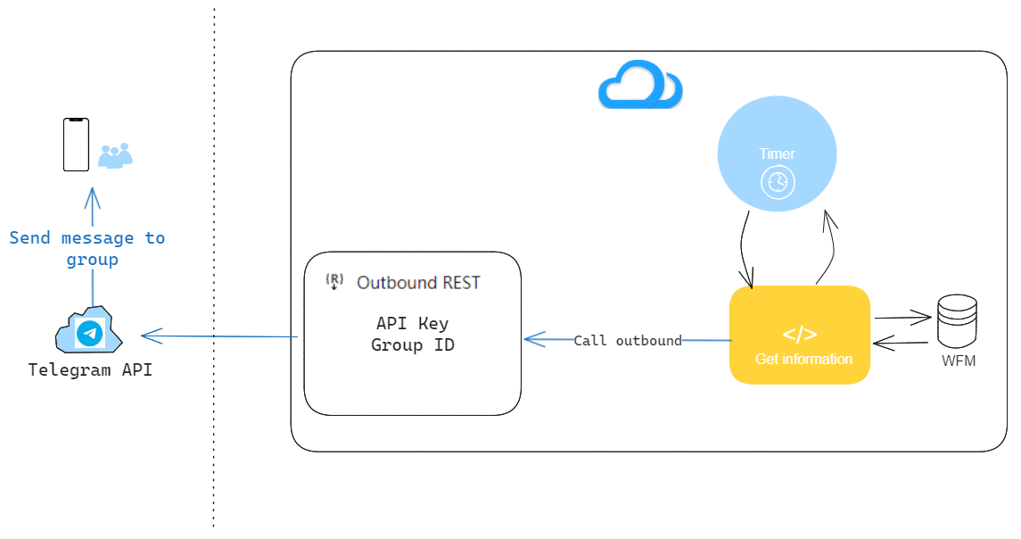
Bot logic
Telegram bot diagram
1.- Cron Job every X time (15 minutes)
2.- Get information from WFM database
3.- Call outbound
4.- API request
5.- Telegram process the request and send the message to configured group

Slide 4
PC page configuration

Slide 5
Bot settings
Max quantity of sending results
Bot API key
Bot chat_id
Bot template

Slide 6
Work plan
Task | Duration
Script to collect data | 1
Outbound service development | 1
Test | 1
Deploymen | 2
Total | 5 working days

Slide 7



Copyright©2014 Huawei Technologies Co., Ltd. All Rights Reserved.
The information in this document may contain predictive statements including, without limitation, statements regarding the future financial and operating results, future product portfolio, new technology, etc. There are a number of factors that could cause actual results and developments to differ materially from those expressed or implied in the predictive statements. Therefore, such information is provided for reference purpose only and constitutes neither an offer nor an acceptance. Huawei may change the information at any time without notice.

